Slide 1
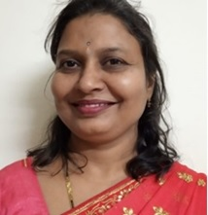
K J Somaiya Institute of Technology, Sion Mumbai-22 (KJSIT – GREEN CLUB) (As per the guidelines by UNICEF and DTE
Dr. Sandhya Kadam, Green Club Faculty Coordinator, KJSIT
Email- sandhyakadam@somaiya.edu
Mob-8108213388
Green Club Email: greenclub.tech@somaiya.edu
Regards,
Dr. Vivek Sunnapwar, Principal, KJSIT

Slide 2
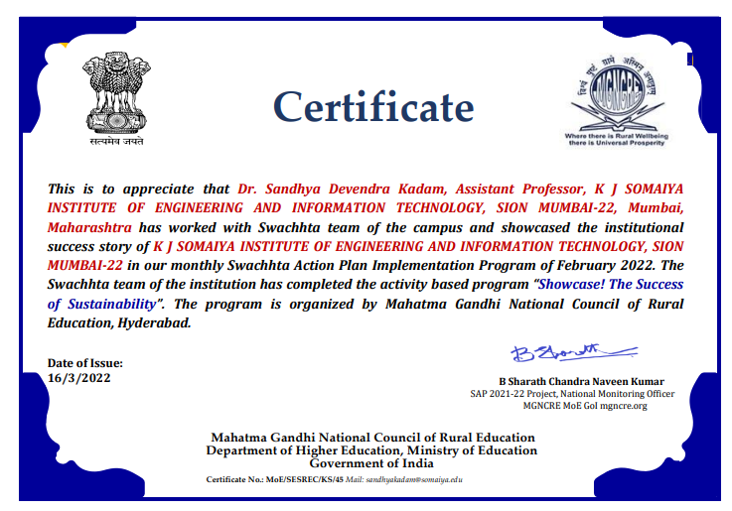
Appreciation by Ministry of Education, Government of India

Slide 3
KJSIT- Green Club: YEWS Initiative 2023-25

Slide 4
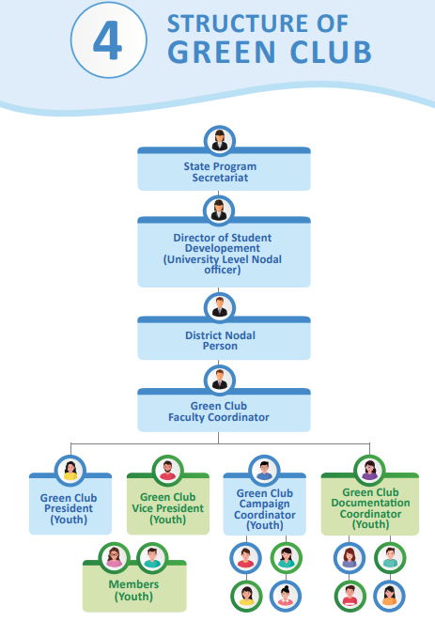
KJSIT- Green Club Structure

Slide 5
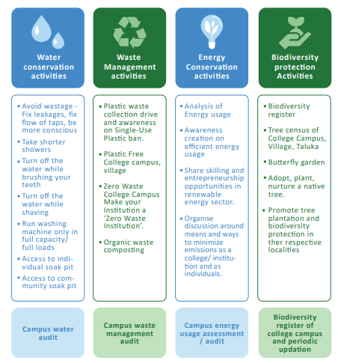
KJSIT- Green Club Activities

Slide 6
KJSIT-Green Club : Objectives
To create environmental and cleanliness awareness among students and staff using various techniques.
To educate students and staff for plantation of more number of trees including medicinal plants and maintaining the Institute campus green by using concept of Reduce, Reuse, Recycle and Recover..
To use smart techniques for saving and efficiently using natural resources for maintaining the Campus Green.
To participate and win as KJSIT with different awards and rankings.

Slide 7
KJSIT-Green Club : Objectives
To create environmental and cleanliness awareness among students and staff using various techniques.
To educate students and staff for plantation of more number of trees including medicinal plants and maintaining the Institute campus green by using concept of Reduce, Reuse, Recycle and Recover..
To use smart techniques for saving and efficiently using natural resources for maintaining the Campus Green.
To participate and win as KJSIT with different awards and rankings.

Slide 8
KJSIT : Environment Policy
Environment Policy refers to the commitment of the organization towards environmental issues. Environment issues addressed by Environment Policy are saving of electricity, air and water pollution, waste management, eco system management, protection and preservation of natural resources for future generations. It follows guidelines as given below:
Communication of environmental issues through various awareness programmes such as Waste management, Cleanliness, Woman health, Yoga, Aerobics, Saving of natural resources etc.
Electronic Communication through email to create awareness of various days as World Environment Day, World Tiger Day to address social issues.
Dedicated staff for cleaning, wastes collection and disposal.
Social dimension for quality of life and health.
Plantation drives at various places as well as in campus to maintain the green environment.
Segregation of waste and waste management to maintain the clean environment.
Implementation of Waste to Wealth project to produce manure from canteen and garden waste for a good quality fertilizer generation.
Purchase of green products and contribute towards maintaining the quality environment.
Recycling of E-waste by an authorized agency.
Use of natural renewable resource such as solar panels to generate electricity.
Implementation of automation and sensors to save electricity.
Encourage projects and initiatives on Afforestation, Landscape and Ecosystem restoration, renewable energy resources.
Inclusion of credit course as Environment Management in the curriculum.
Apply for the Awards such as Clean and Green Campus and Swachhata Ranking of Higher Educational Institutes, initiatives by AICTE and various bodies.

Slide 9
KJSIT-Green Club : Outcomes
Students and Faculty and Staff members encourage and motivate others for plantation and maintenance of more number of trees and medicinal plants.
Students and Faculty and Staff members receive awareness messages through mail so that they help themselves and others to make a difference in day to day life- A step towards Green Campus as a zero waste zone by saving and maintaining natural resources with the help of smart techniques.
Students and Faculty and Staff members learn different ways to Reuse, Reduce, Recycle and Recover different kinds of waste materials.
KJSIT has received appreciation and participation certificates from various Government and Non-Government Organizations/ NGOs.

Slide 10
KJSIT-Green Club YEWS

Slide 11
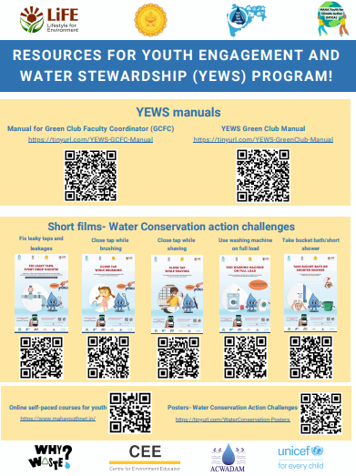
KJSIT-Green Club YEWS

Slide 12
Self Paced Courses
Details mailed by Principal Sir.
Pl register at MYCA Online (mahayouthnet.in) and complete the online courses. The courses are -
1. Living with Climate Change and Water Management
2. Waste Management and Climate Action
3. Energy Management and Climate Action
4. Bio-Cultural Diversity Conservation and Climate Action
You will receive 04 e_certificates after completion of the courses. Pl mail the certificates at greenclub.tech@somaiya.edu

Slide 13
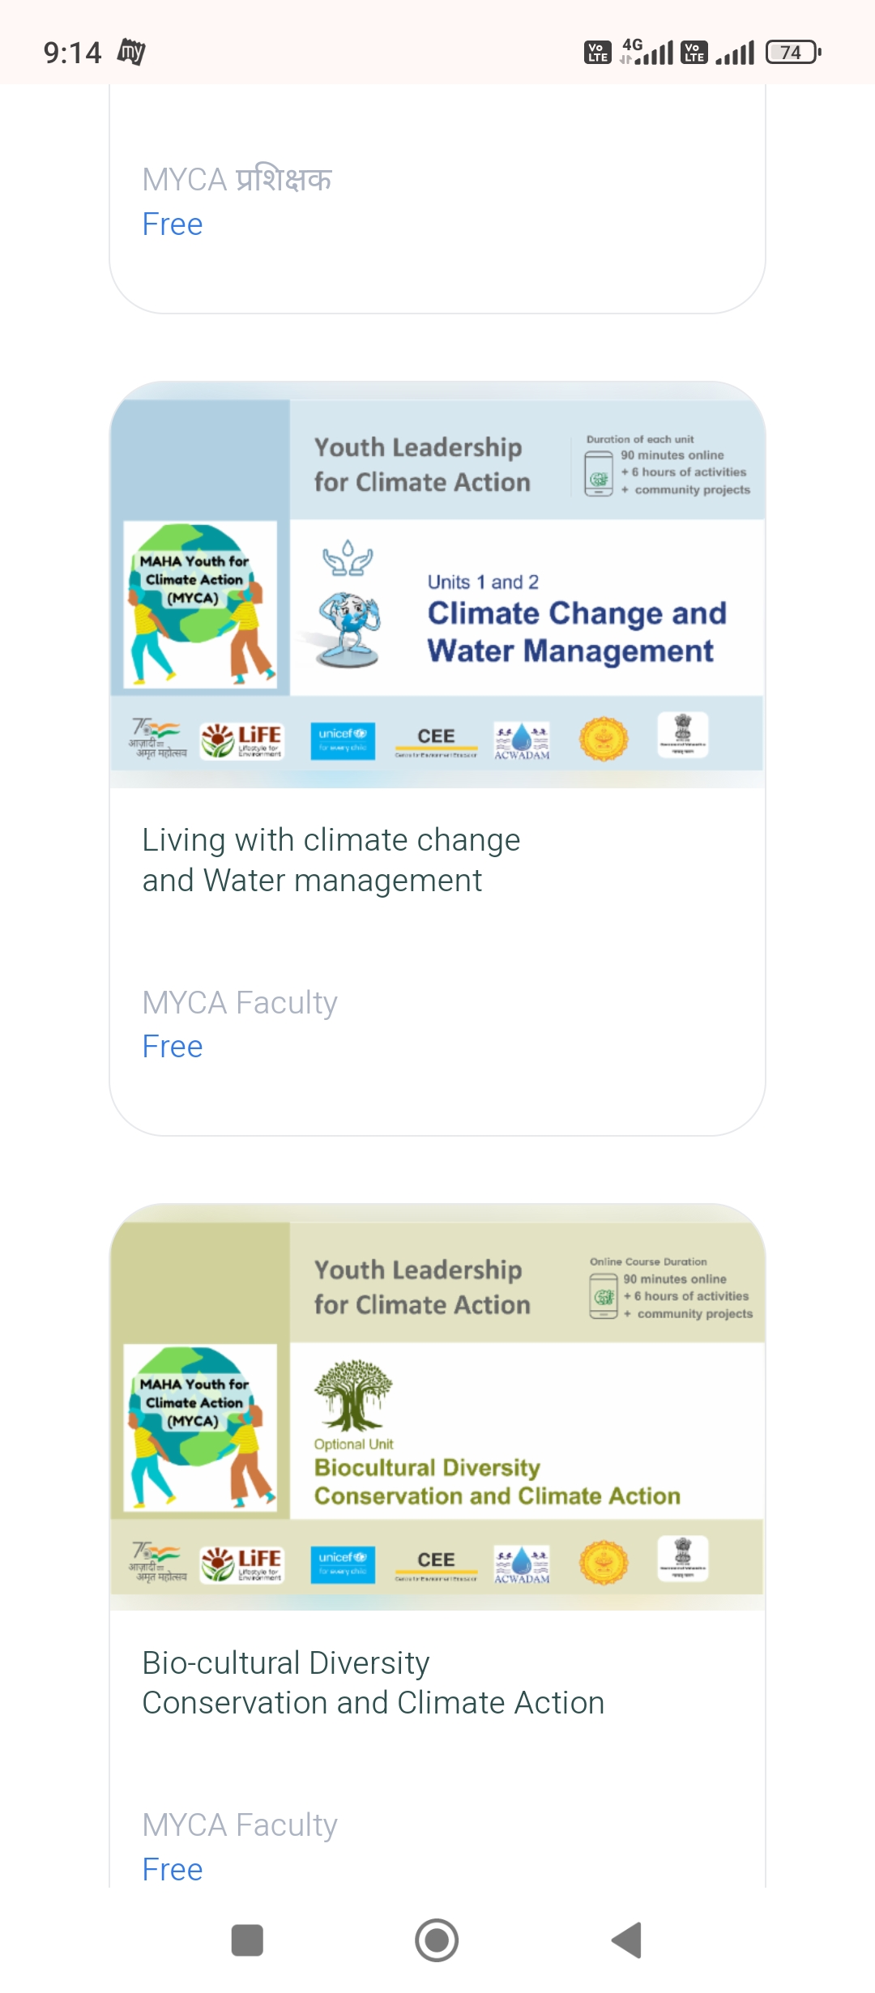
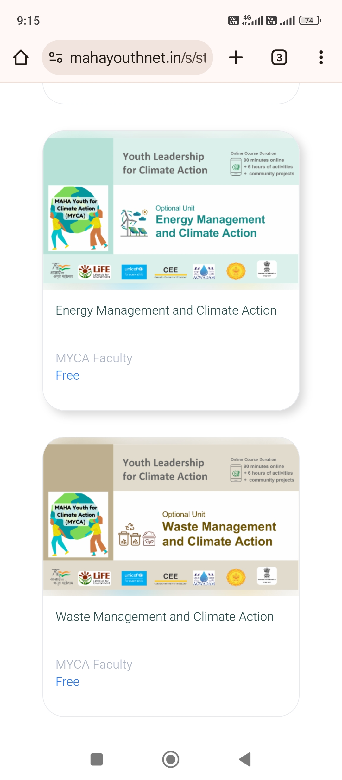
KJSIT- Green Club: YEWS Initiative 2023-25

Slide 14
Why waste App
Details mailed by Principal Sir. Through YEWS (Youth Engagement and Water Stewardship) program, KJSIT – Green Cub expects every student and teacher to register and install Why Waste? App. You are already invited as registered user of Why Waste App through your Somaiya Email id.
The steps to register and Install Why Waste App are as follows:
1. Select Why Waste (YEWS) App from Play Store
2. Select Signup Option as Through GCFC (Green Club Faculty Coordinator)
3. Fill in the details given to register on Why Waste App.
4. Login with Somaiya Email id.
5. Password- abcd1234
6. Click on Install, Why Waste App will get installed.
7. After Installation, open Why Waste App and take a Quiz to know your water footprint.
8. Everyday take a challenge to save water through Why Waste App. Daily Challenges are actions taken.
Challenges assigned are Easy Action, Medium Action and Hard Action.
9. Click on Daily Challenge to select Easy/ Medium/ Hard Challenges and perform it for the day.
10. Updating daily challenge will save water.
11. Water saving by KJSIT through Why Waste App will be recorded as Total Water Saving by the Institute.

Slide 15
Green Enthusiast & Green Champion Certificate
Eligibility:
1. Completion of self Paced Courses.
2. Installation of Why Waste App.
3. Participating Green Club activities.

Slide 16
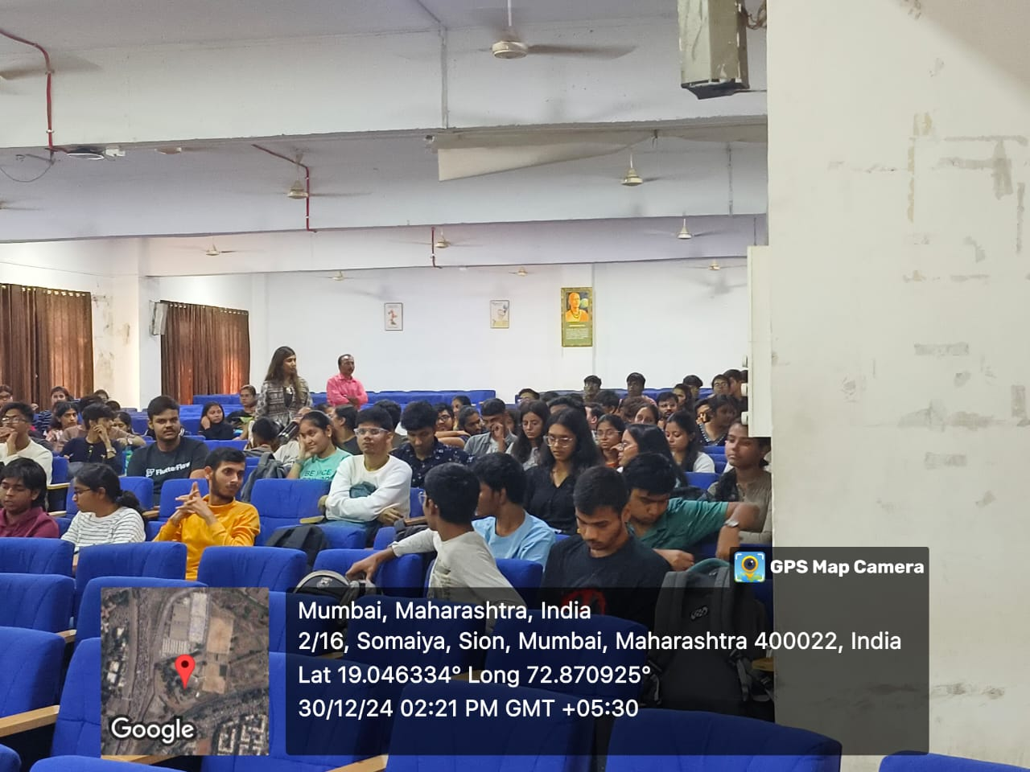
Green Club Induction & Orientation 2024-25

Slide 17
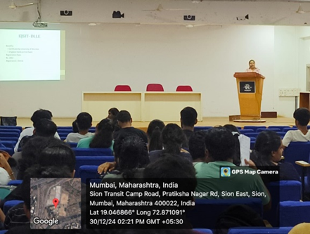
Green Club Activities-2024-25

Slide 18
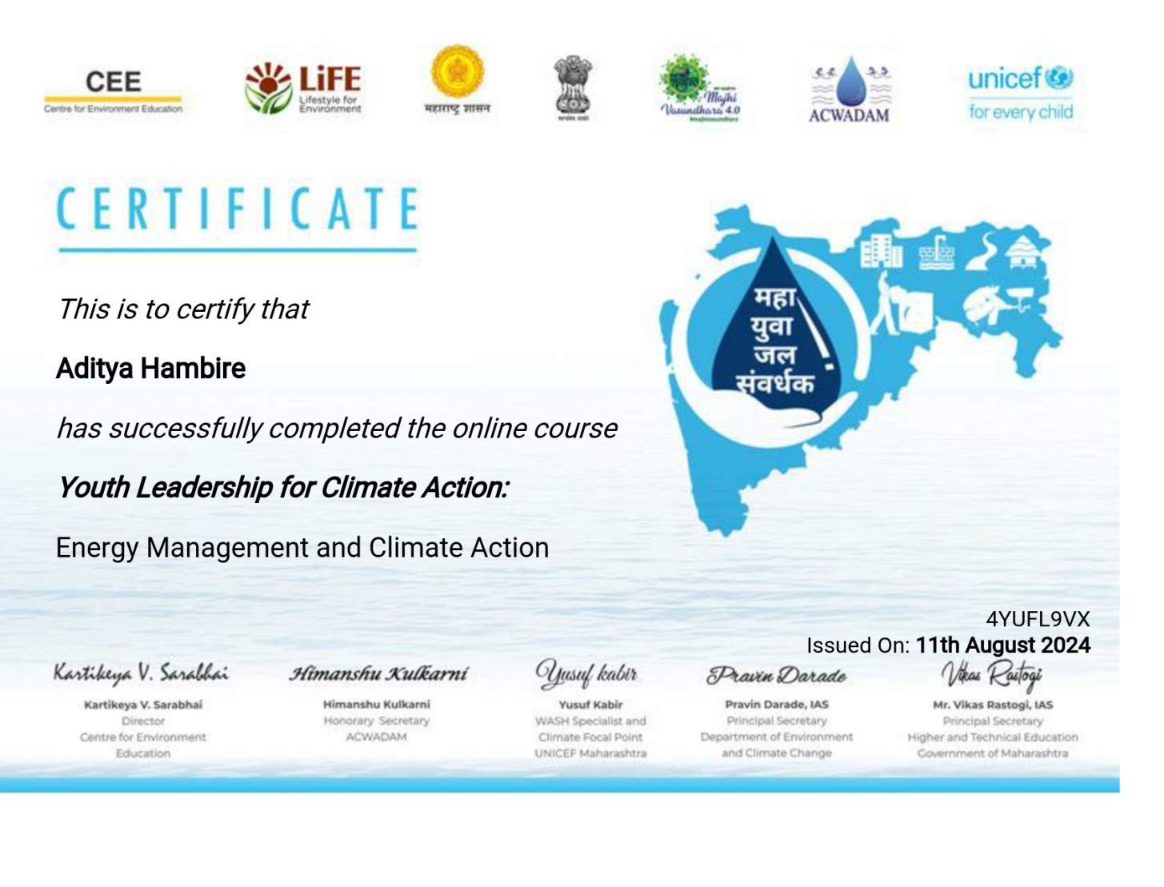
Green Club Certification for Youth Leadership for Climate Action

Slide 19
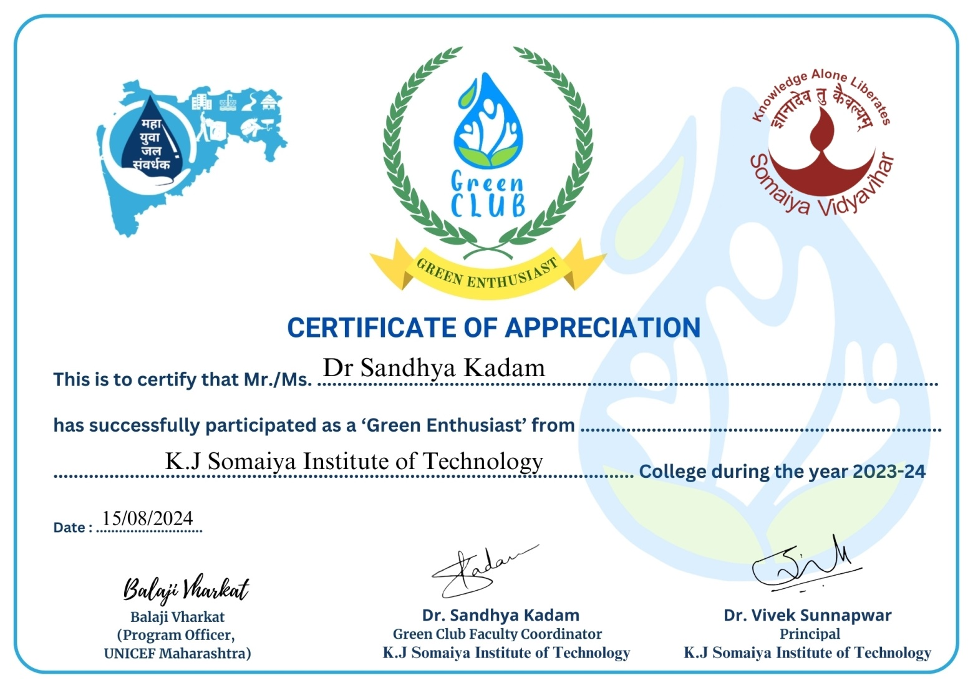
Green Club Enthusiast Certification

Slide 20
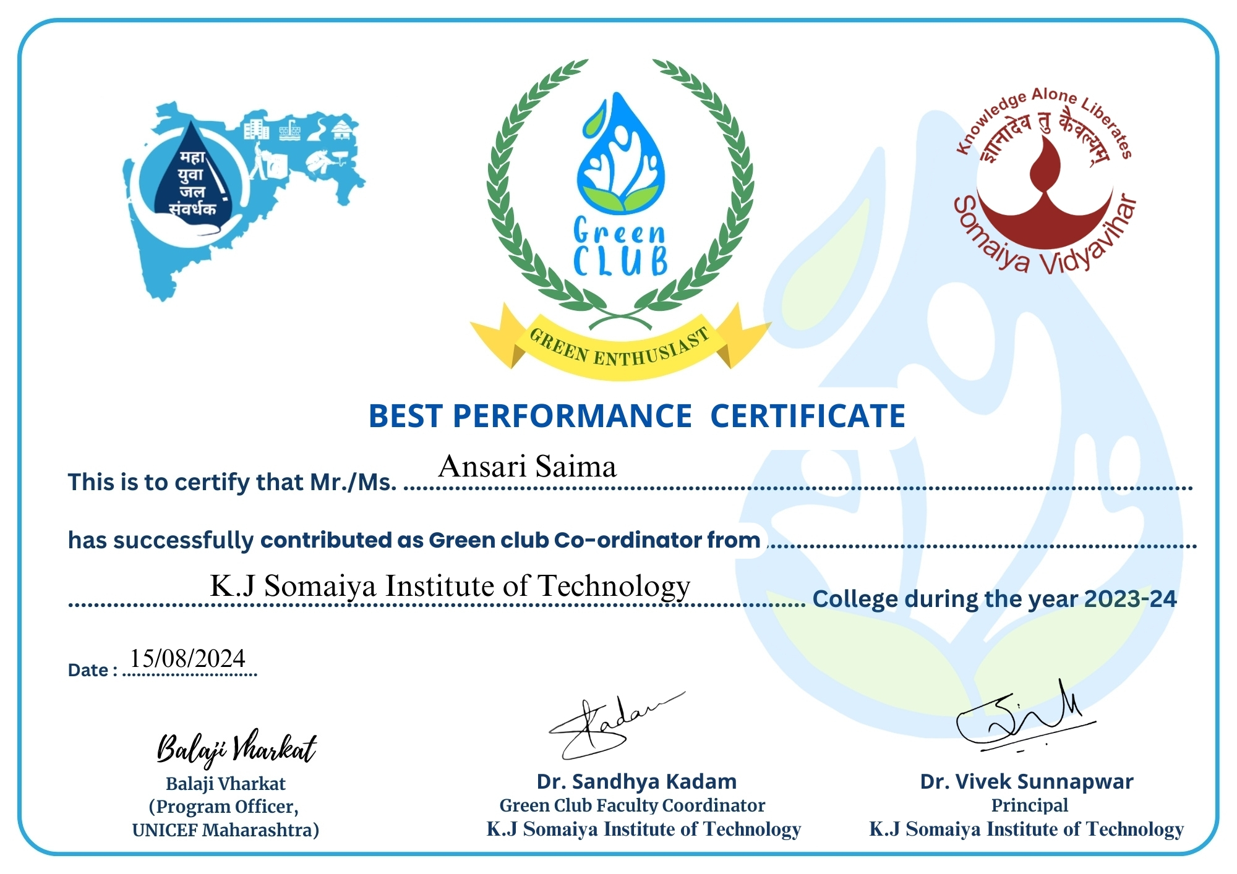
Best Performer Certificate

Slide 21
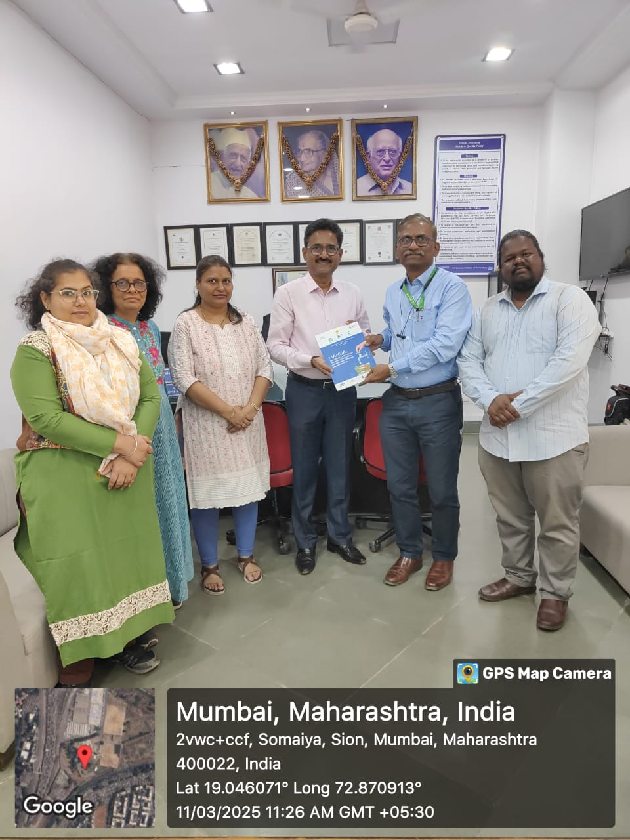
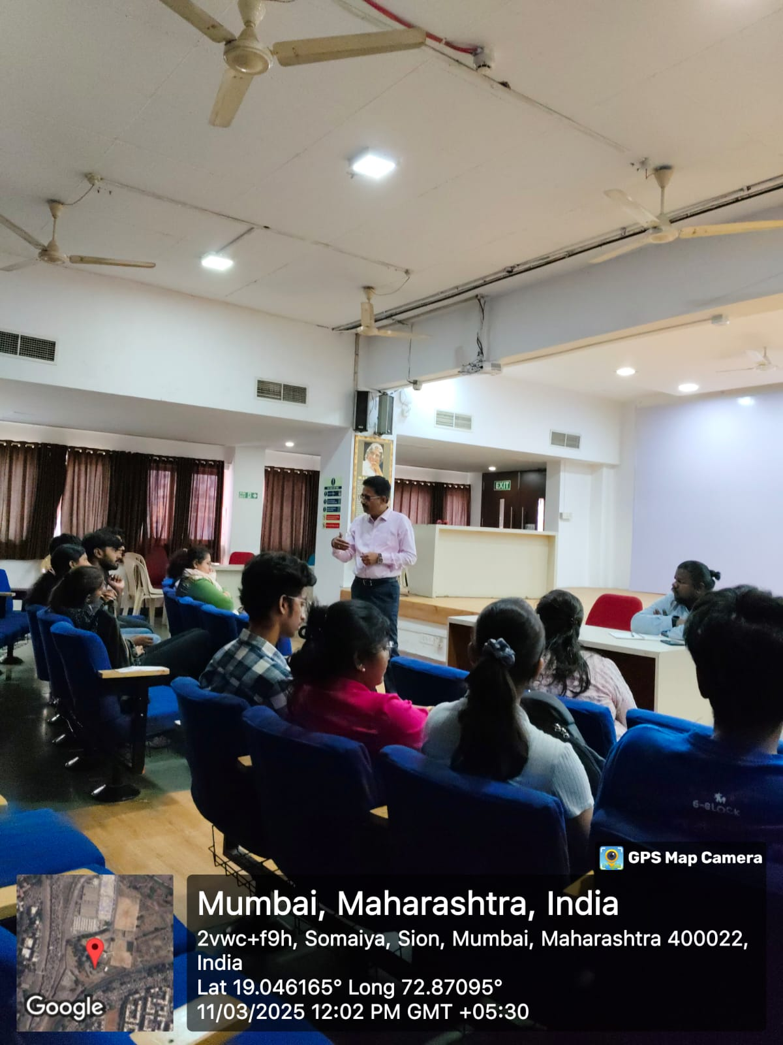
Green Club Review : Master Trainer & YEWS District Coordinator

Slide 22
Green Club Short Term Plans
Short Term Future Plans:
Competitions consist of essays, quizzes, and drawings, paintings, Slogan etc. related to environmental issues can be conducted
Poster presentations on environmental issues can be conducted
Waste Segregation at multiple levels can be done through management system.
Awareness drives on environmental issues can be conducted
Plantation Drives can be conducted to motivate students and staff to plant more number of trees and maintain clean and green campus.

Slide 23
Green Club Long Term Plans
Long Term Future Plans:
Green Institute Campus with Ranking.
Zero waste Institute zone.
To conduct more number of plantation drives to increase green cover.
To participate and win KJSIT as Clean, Green and Smart Institute in various Competitions and Awards.

Slide 24
Thank You!

